Slide 1
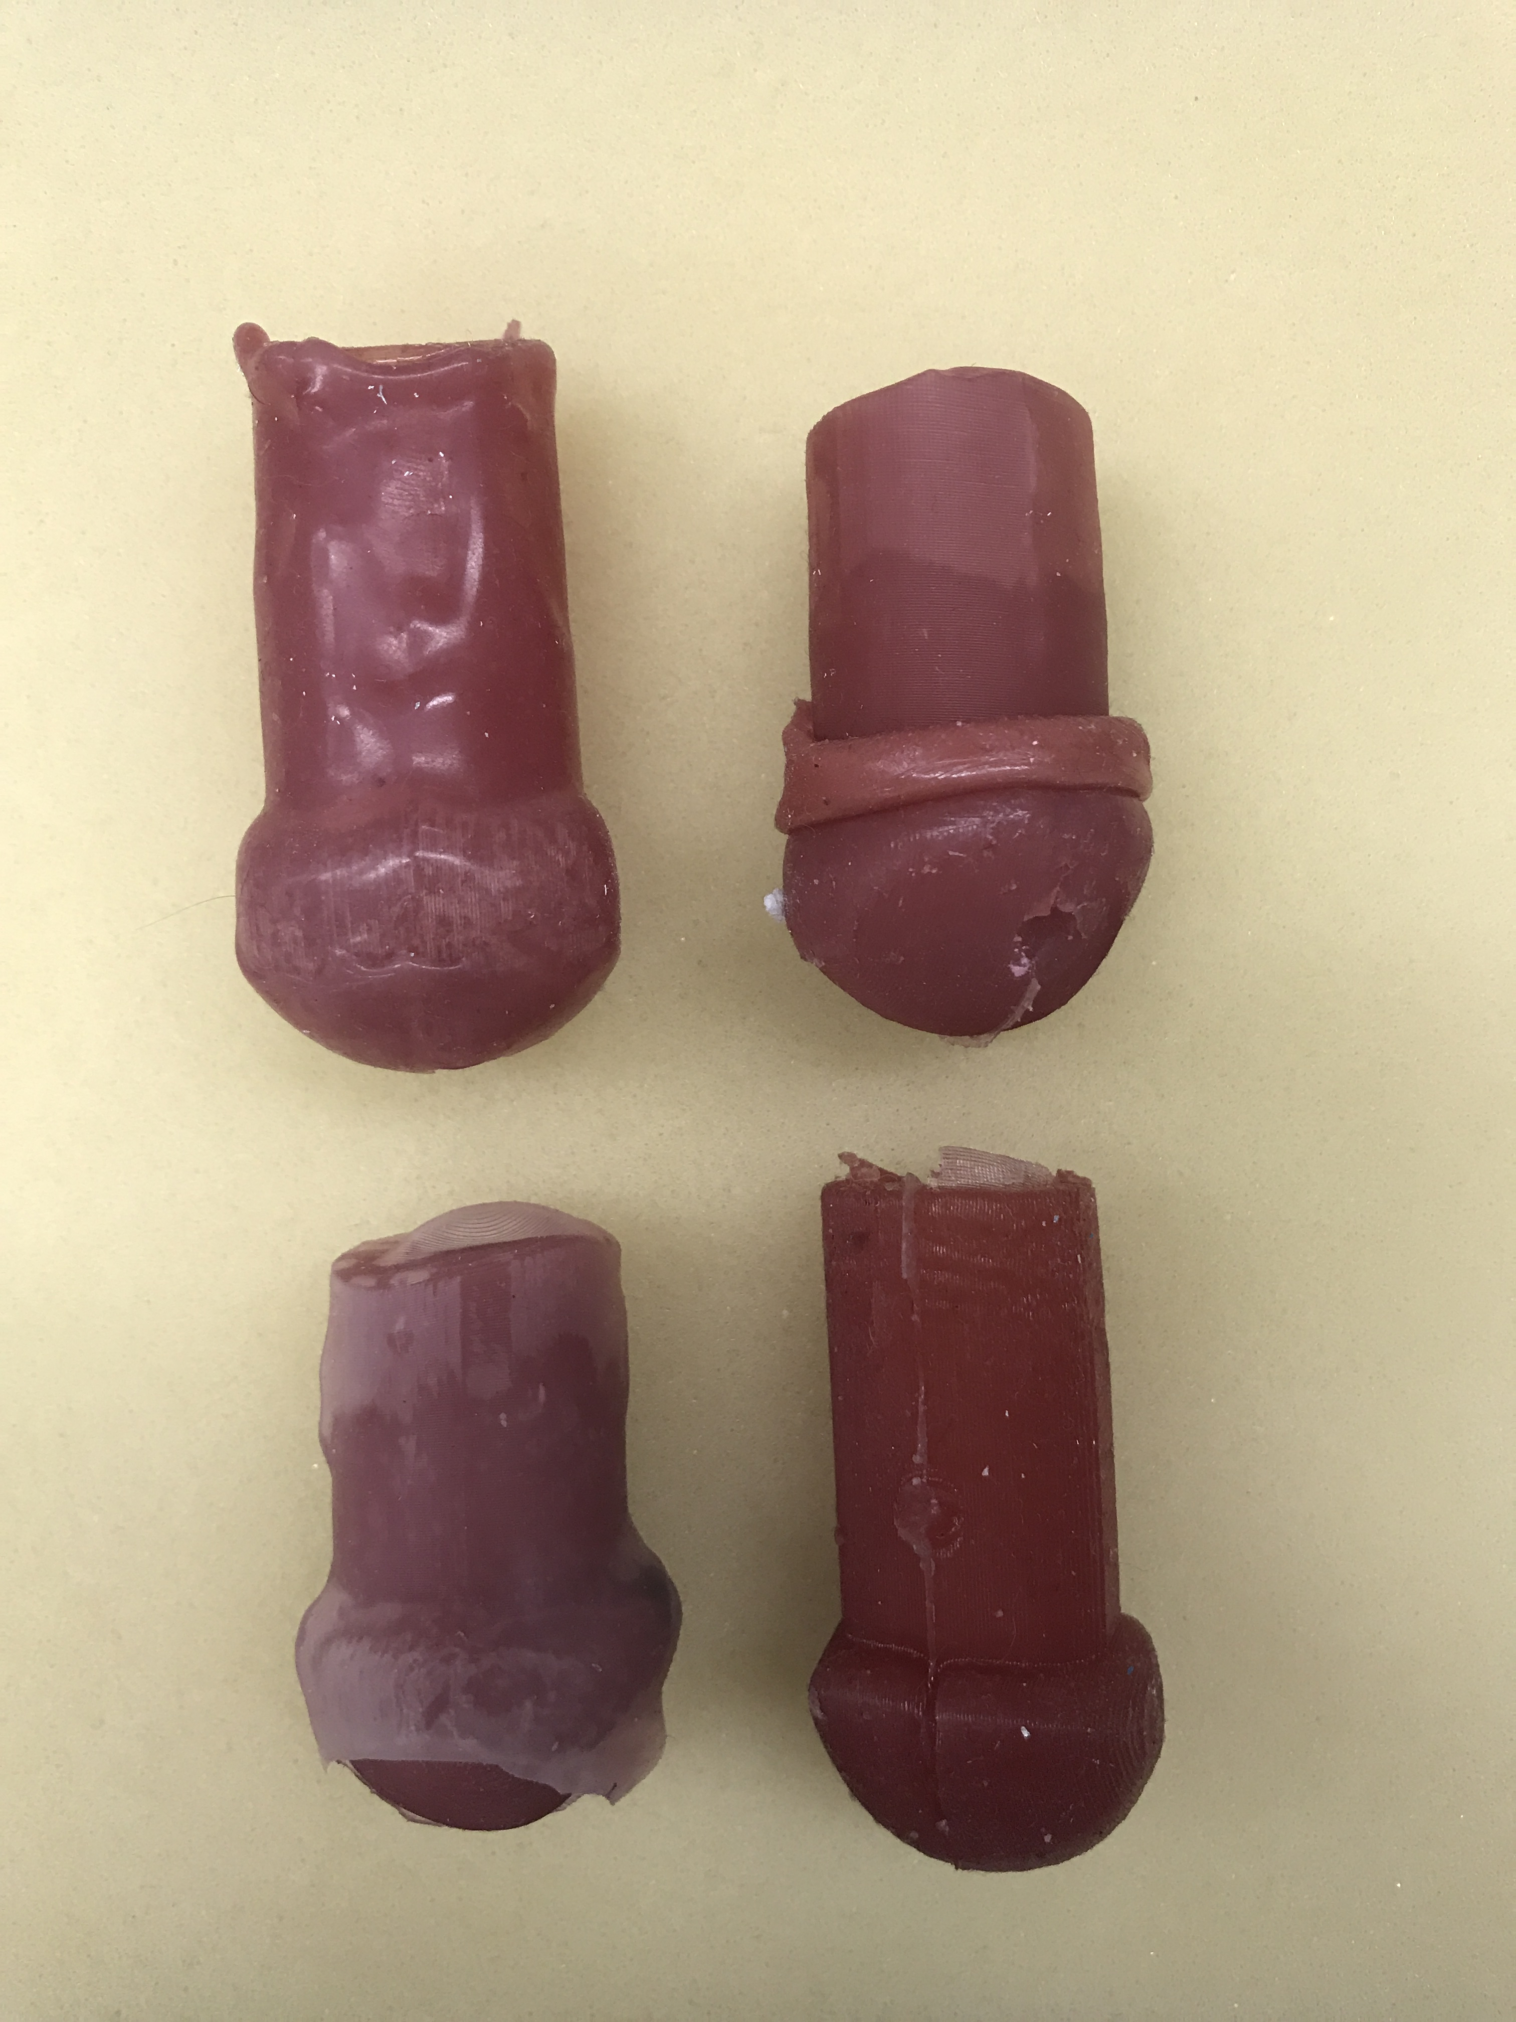
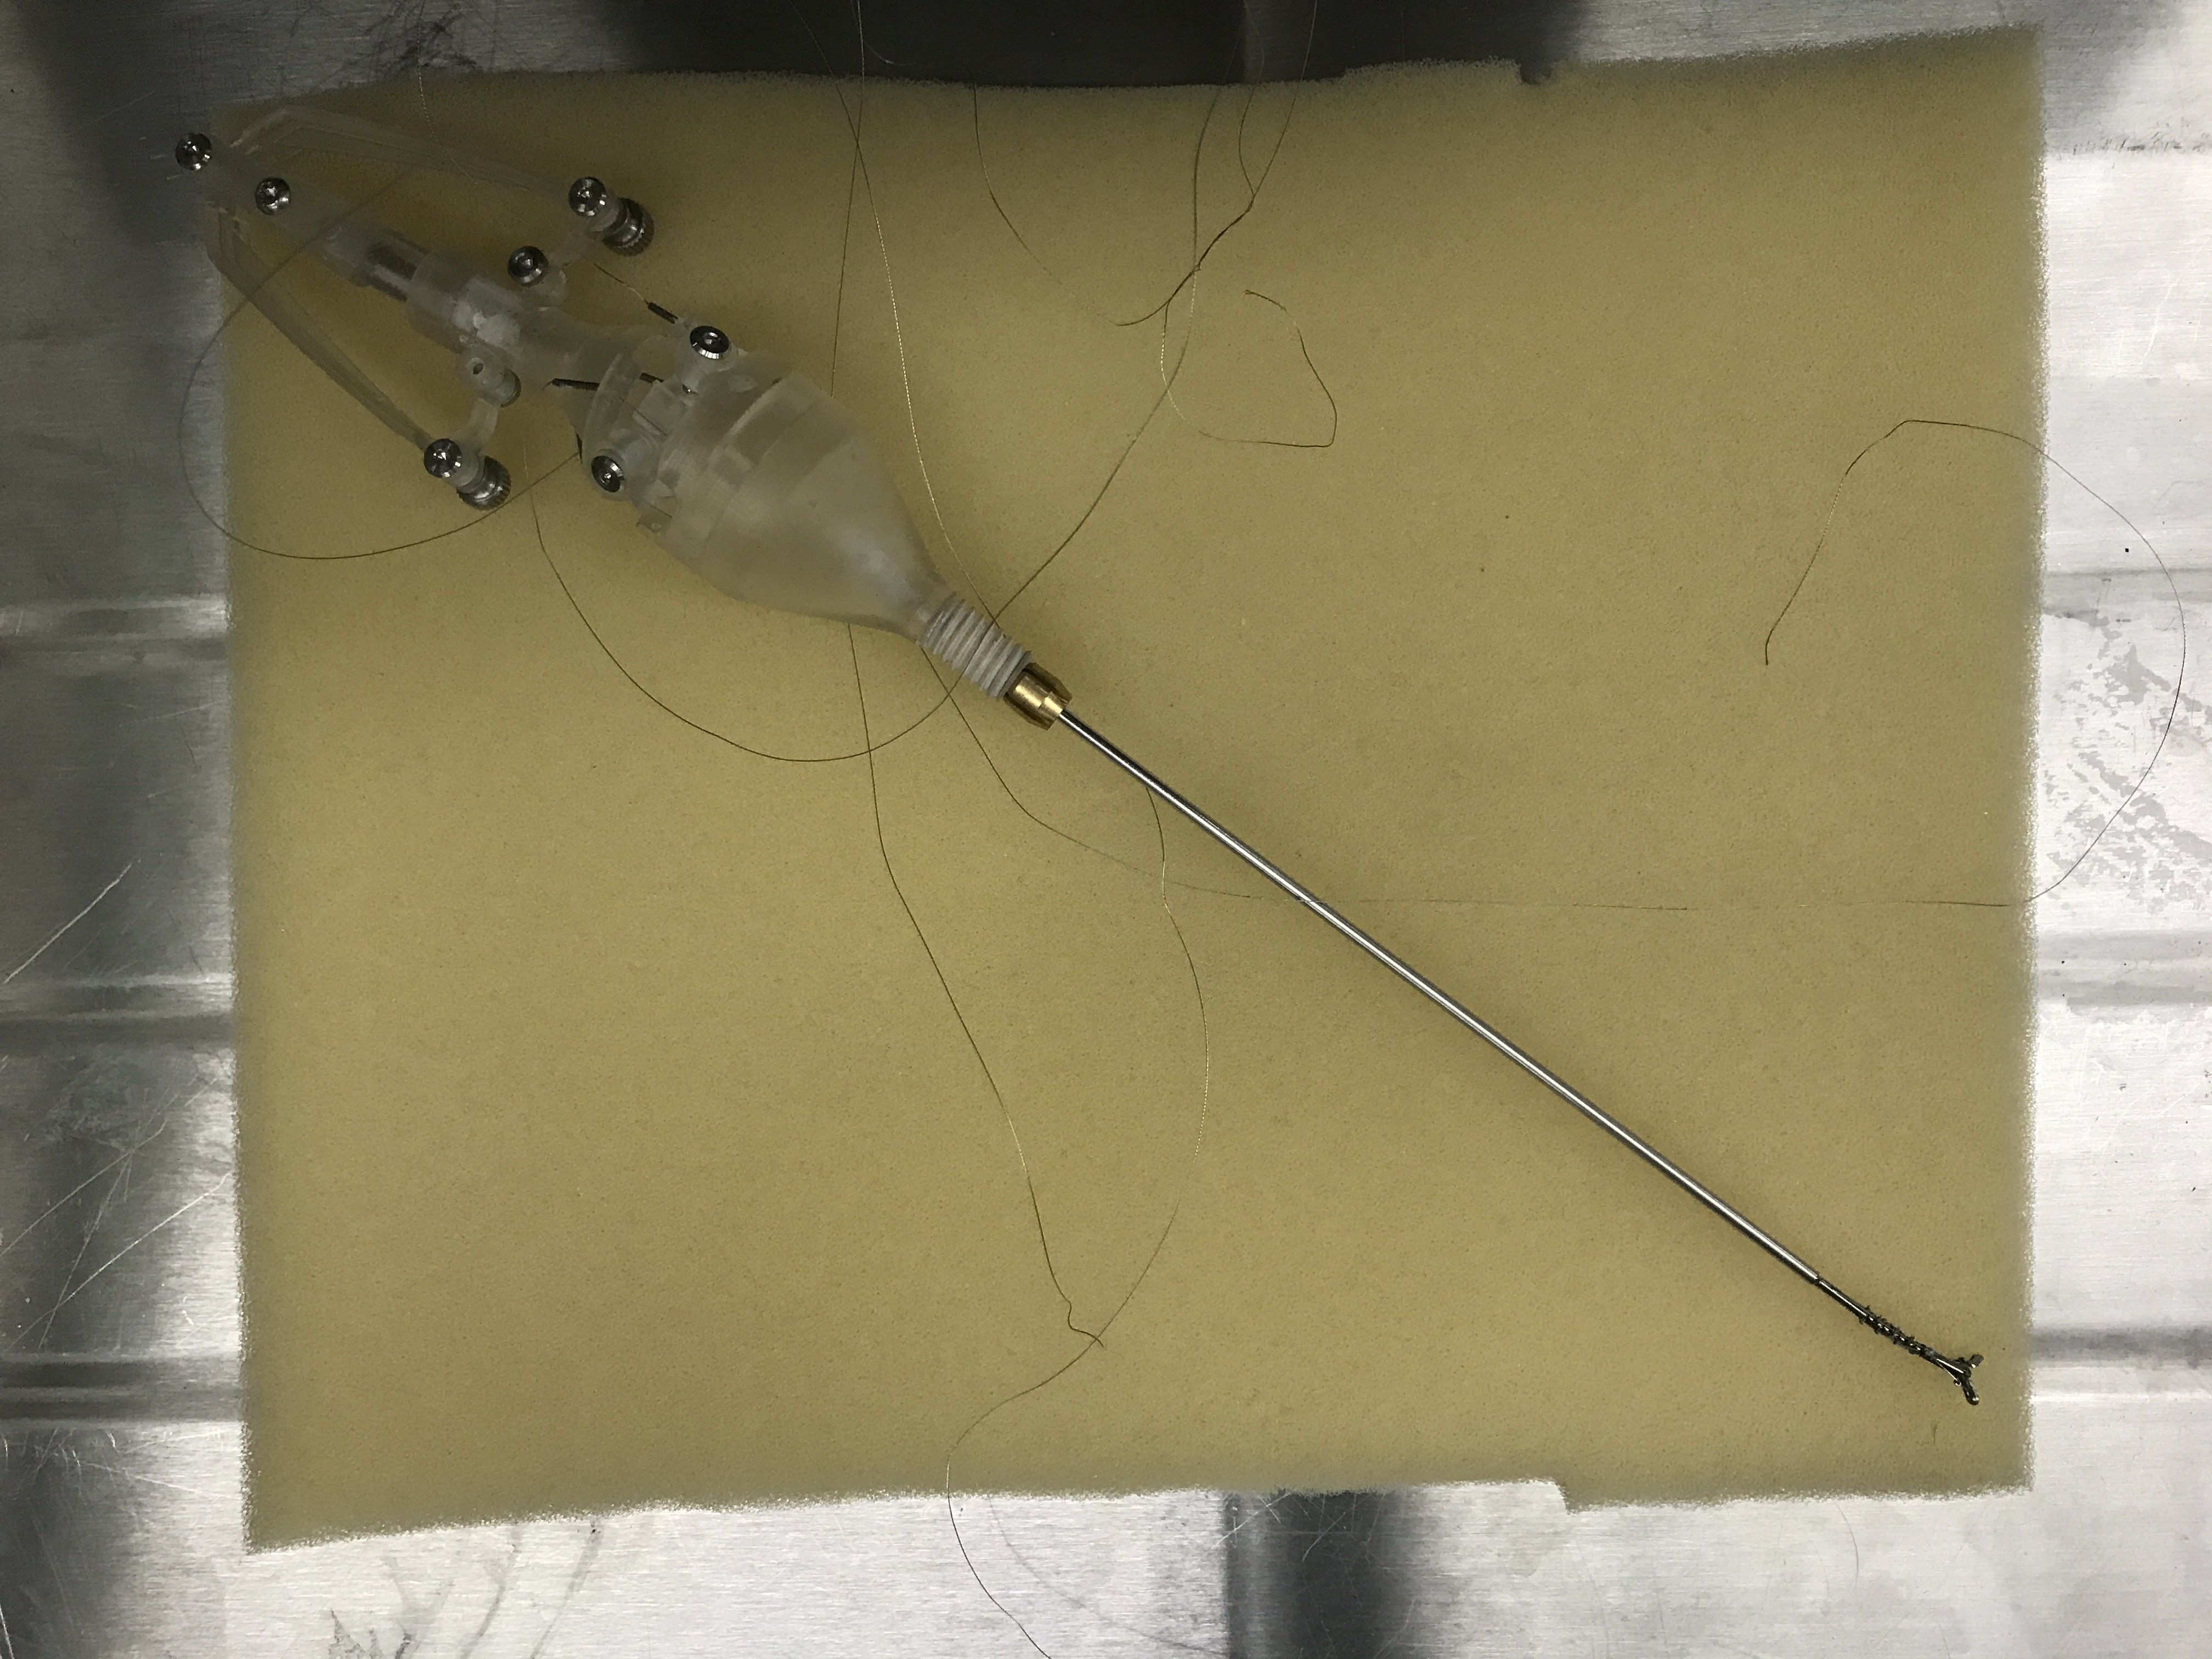
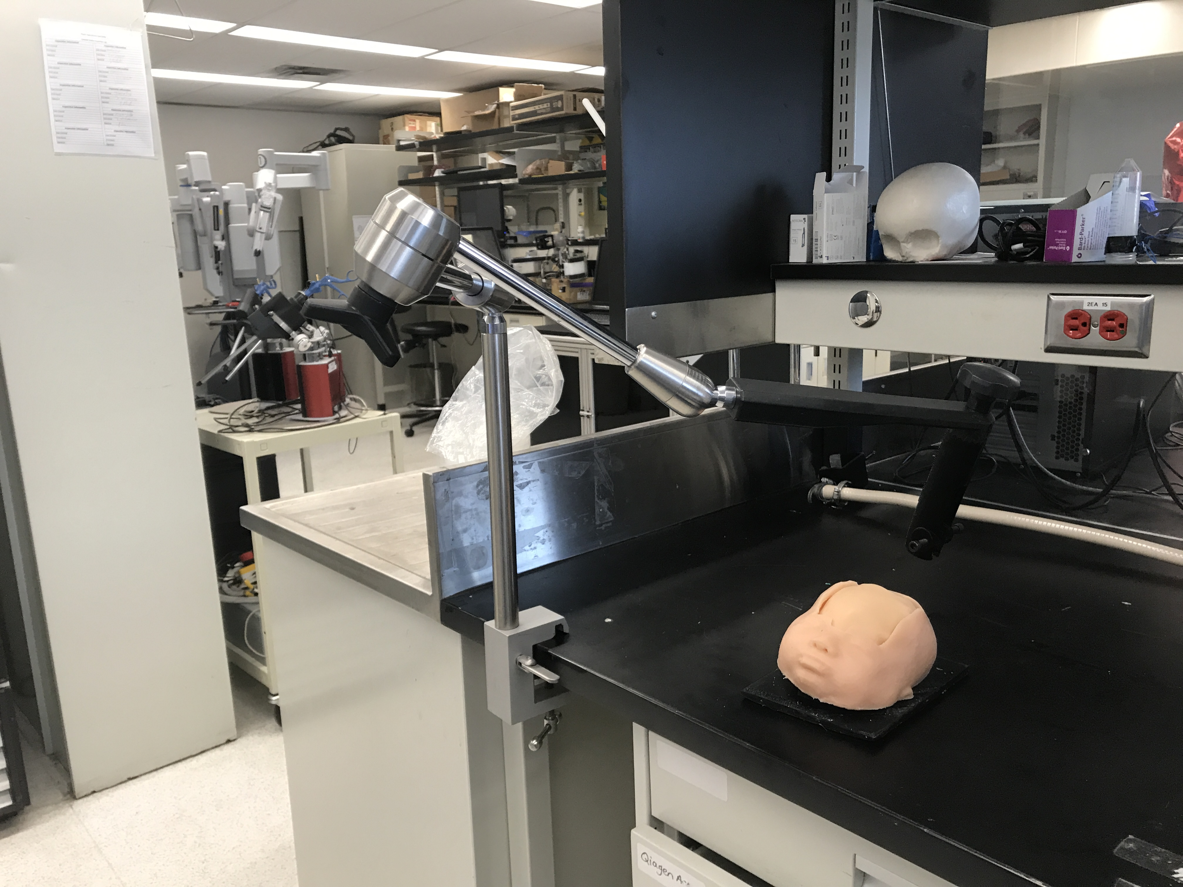
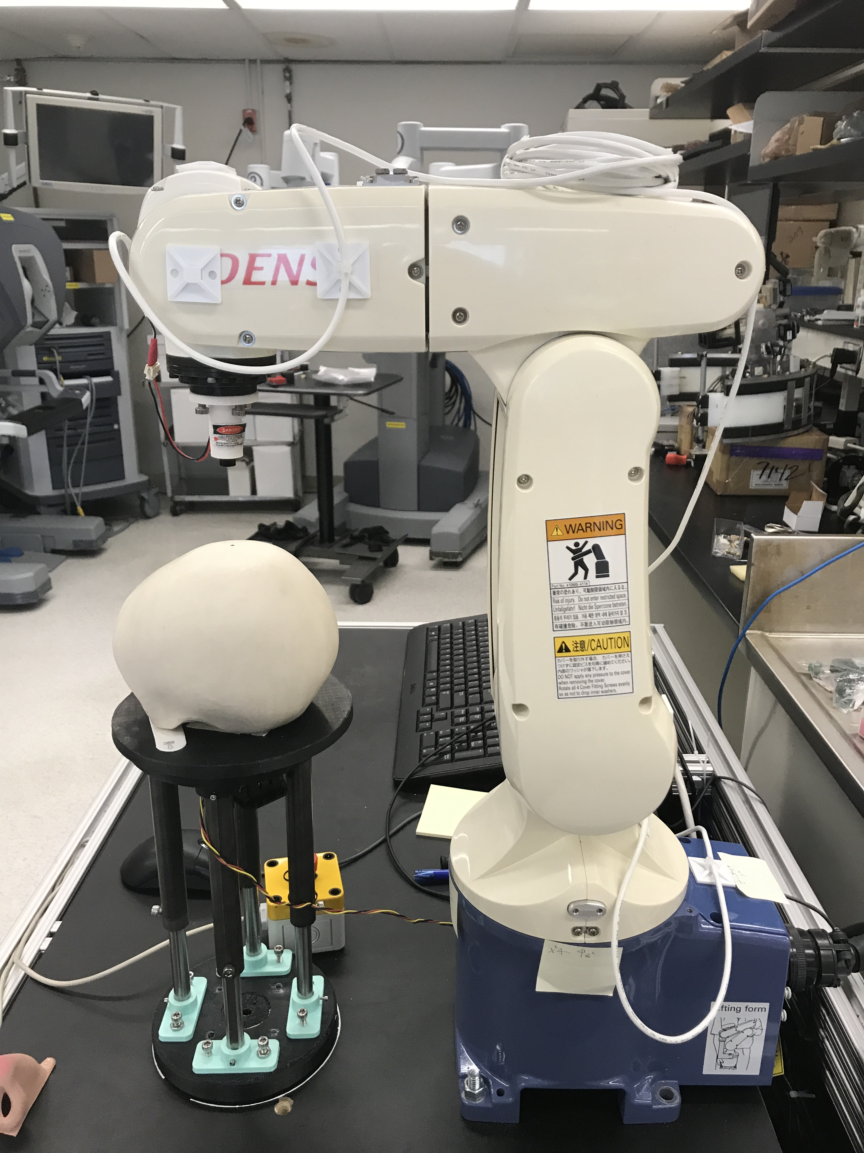
Circumcision Model and Tool | Tool Handle Design for Dexterous Surgical Tools
Improving Endoscopy Control | Assistive Robotic Trocar Holder
http://compass.xbox.com/assets/d3/d8/d3d83d26-d0df-49b8-9ad2-f213425a091d.jpg?n=X1-Wireless-Controller-Black_Gallery_1056x594_02.jpg

